Slide 1
“Nuovi strumenti di finanziamento:
l’esperienza dei Schuldscheindarlehen in Germania e il confronto con i Mini-Bond in Italia”
The European perspective on private placements
Giovanni Guazzarotti
Servizio Stabilità Finanziaria

Slide 2
OUTLINE
Why we need more non-bank finance
The economics of private placements
The case of the Italian corporate bond market
Creating a European market for private placements

Slide 3
LIABILITIES OF NON FINANCIAL COMPANIES
percentage points
Source: ECB and Italian financial accounts.

Slide 4
DRAWBACKS OF A BANK-BASED FINANCING MODEL
Financial stability
during recessions a self-reinforcing mechanism links firms’ financial fragility with the quality of banks’ balance sheet
Long-term financing
bank credit is not best suited to address the financing needs of firms which have the highest growth potential
Banks’ business model
tougher regulation, high operating costs, new technologies, diversification of sources of income

Slide 5
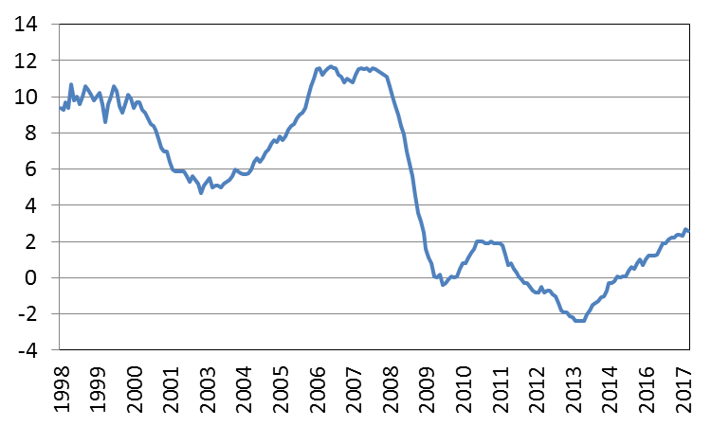
EURO AREA: BANK LENDING TO PRIVATE SECTOR
monthly data, annual growth rate
Source: ECB.

Slide 6
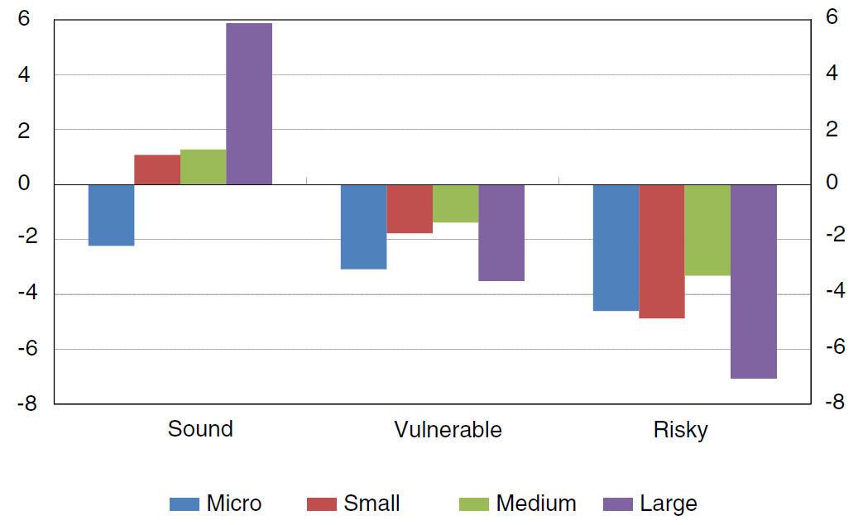
ITALY: BANK LOANS BY SIZE AND RISK CATEGORY
average 2014-16; 12-month percentage changes
Sources: Based on Bank of Italy and Cerved data.

Slide 7
THE ECONOMICS OF PRIVATE PLACEMENTS
Private placement vis-a-vis bank loans and public placements
Issuing costs, contractual flexibility, liquidity, information, expected returns
Firms: medium-to-large firms, with stretched balance sheet, high growth prospects, long-term investment projects
Investors: institutional, specialized, role of banks
Not a substitute for bank credit or public markets (market size is small: US: 0.3% of GDP)

Slide 8
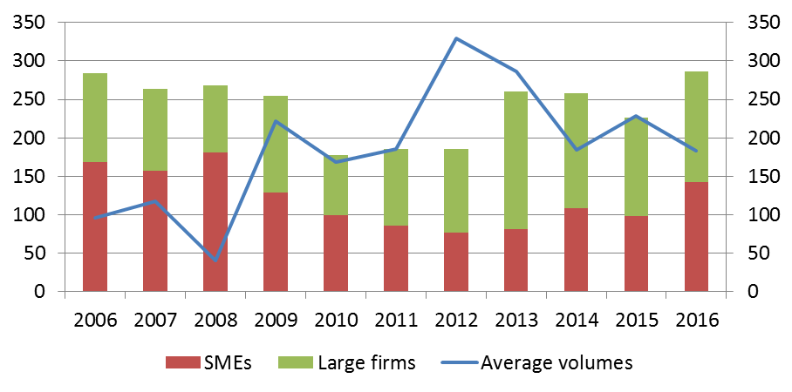
THE ITALIAN CORPORATE BOND MARKET
number of issues; millions of euros
Sources: Based on Bank of Italy and Cerved data.

Slide 9
BOND ISSUERS
An analysis of the Italian market (Accornero et al., Bank of Italy, 2015) shows that:
issuance depends on reputation and transparency (firm size, listing), sound economic and balance sheet situation (leverage, growth), investment activity
Currently, only a very small number of firms in Italy meet these conditions.
SMEs are hindered by: opacity, cost of issuance, high leverage, lack of knowledge (in 2015 40% of firms did not know about minibonds)

Slide 10
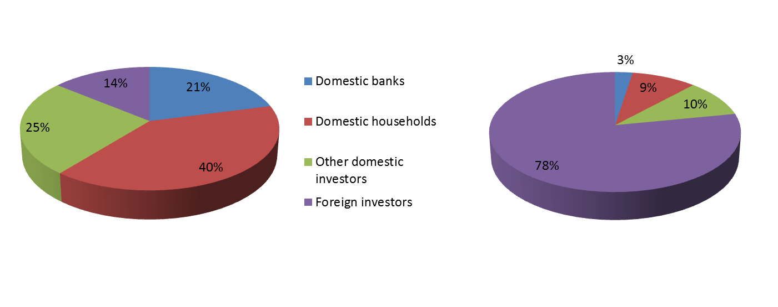
BOND HOLDERS
percentage shares based on outstanding amounts; end 2015
SMEs Large firms
Sources: Bank of Italy, Cerved.

Slide 11
CREATING A EUROPEAN MARKET FOR PRIVATE PLACEMENTS
Long-term finance
fiscal and regulatory incentives to patient capital, public sponsored investment funds
Information
better informed firms/investors, harmonised statistics on SMEs, financial counseling
Market infrastructure
harmonised rules/practices/documentation, specialized intermediaries, remove cross-border tax barriers, harmonize insolvency laws, secondary market for loans

Slide 12
Thank you for your attention

